Slide 1
Management and Organization of Online Classes: Challenges and Opportunities
By
Dr. Sheikh Abu Reza
Former Director (P&D), DTE &
CBT&A Trainer

Slide 2
Management and Organization of Online Classes: Challenges and Opportunities
The COVID-19 pandemic disrupted education worldwide, affecting 91% of students.
Schools, Institutes and universities shifted rapidly to online learning due to closures.
This sudden change encouraged innovation and use of digital tools.
The crisis may accelerate a long-term shift toward tech-driven education

Slide 3
Main Challenges & Opportunities of organizational behavior are:
✅ Challenges
💻 Limited internet access in rural or remote areas.
📱 Lack of digital devices for all students and teachers.
🧑‍🏫 Teachers’ limited ICT skills and unfamiliarity with online tools.
🏠 Distractions at home affecting students' focus and attendance.
📊 Difficulties in assessing student performance and maintaining academic integrity.

Slide 4
🌟 Opportunities
🌍 Access to education from anywhere, reducing geographic barriers.
🎥 Use of multimedia and interactive tools for better engagement.
🕒 Flexible learning schedules for students and teachers.
📚 Availability of recorded lectures for repeated learning.
🤝 Collaboration through online platforms with peers and global educators.

Slide 5
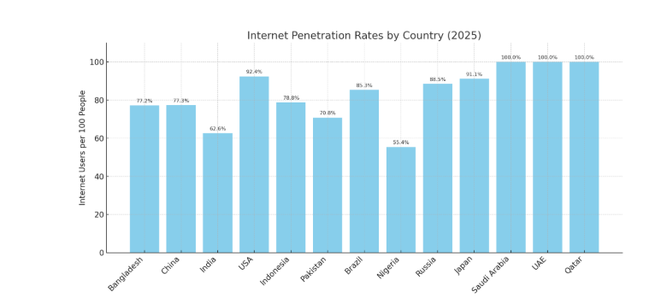
Internet Penetration Rates by Country in 2025 users per 100 people

Slide 6
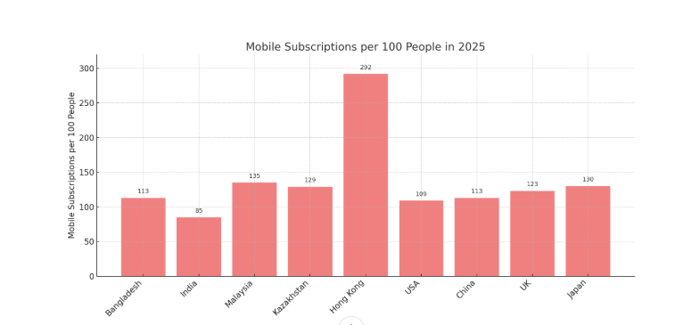
Mobile subscriptions per 100 people in 2025

Slide 7
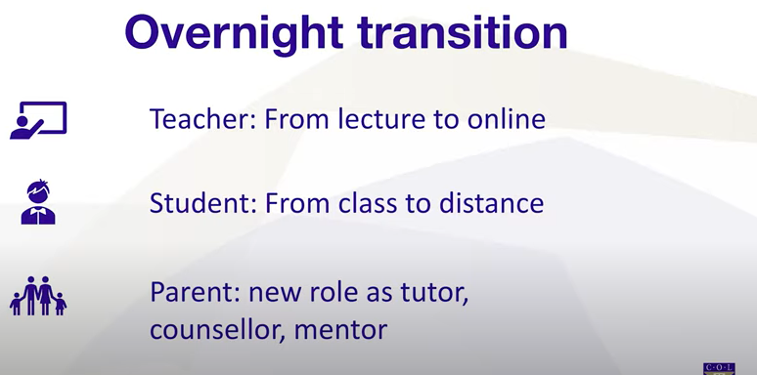
Pedagogical Challenge

Slide 8
3 Type Content
Main contents are:
Student–Student: Collaborative tasks, group chats.
Student–Teacher: Live classes, feedback sessions.
Student–Content: Self-paced modules, videos, quizzes.

Slide 9
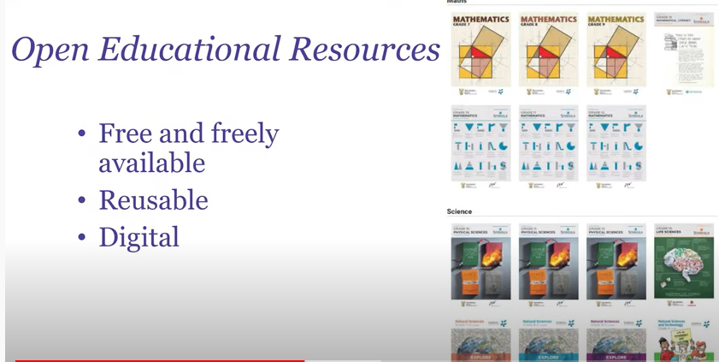
Quality Contents

Slide 10
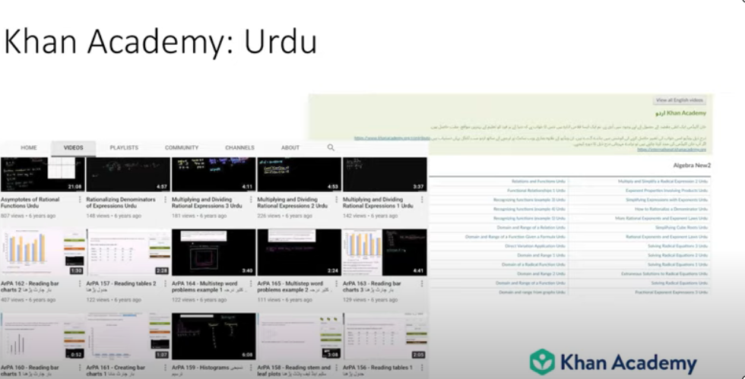
Khan Academy USA

Slide 11

Learner & Learning Support

Slide 12
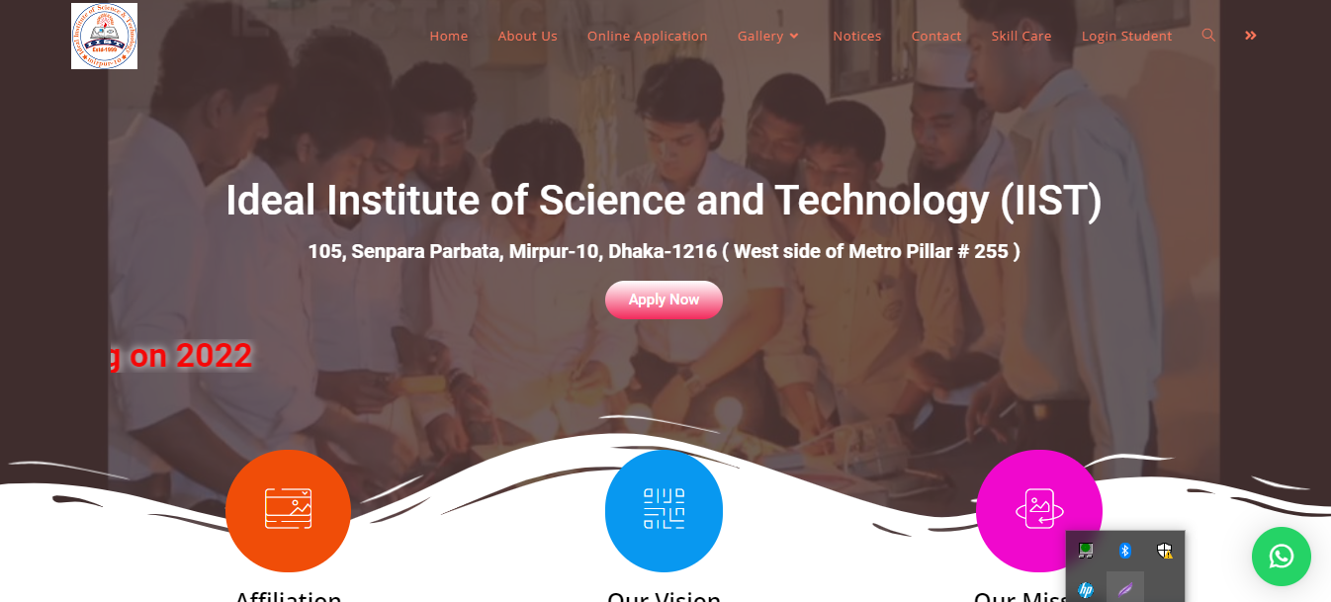
IIST Mirpur-10, Dhaka-1216
Ideal Institute of Science & Technology (IIST)

Slide 13
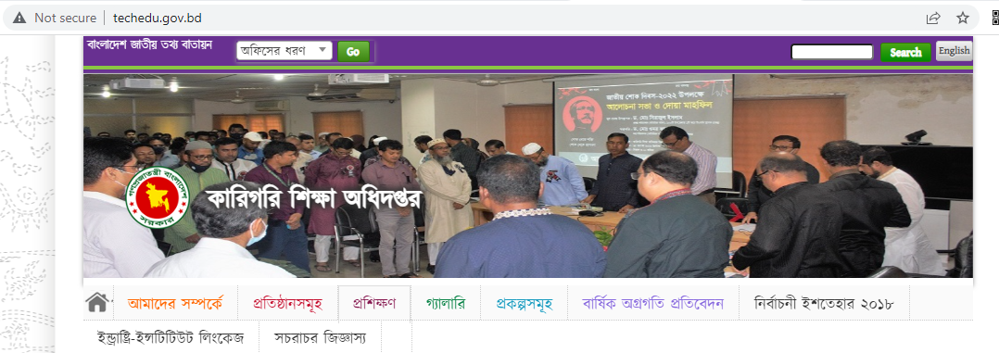
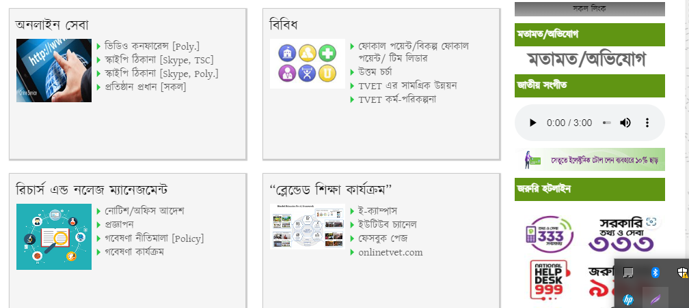
LMS E-CAMPUS DTE, BANGLADESH

Slide 14

LMS E-CAMPUS DTE, BANGLADESH

Slide 15
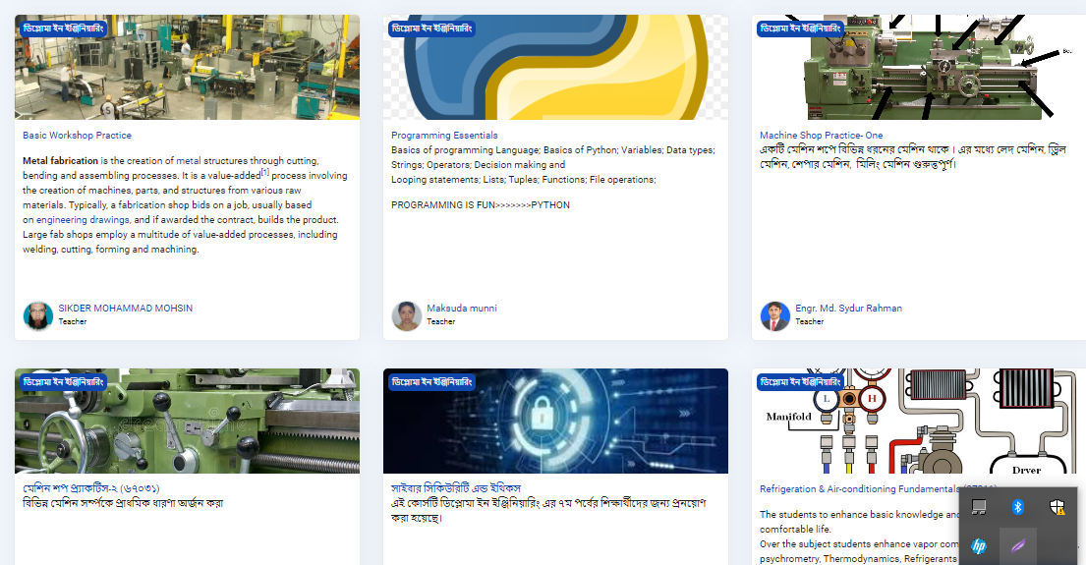
LMS E-CAMPUS DTE, BANGLADESH

Slide 16
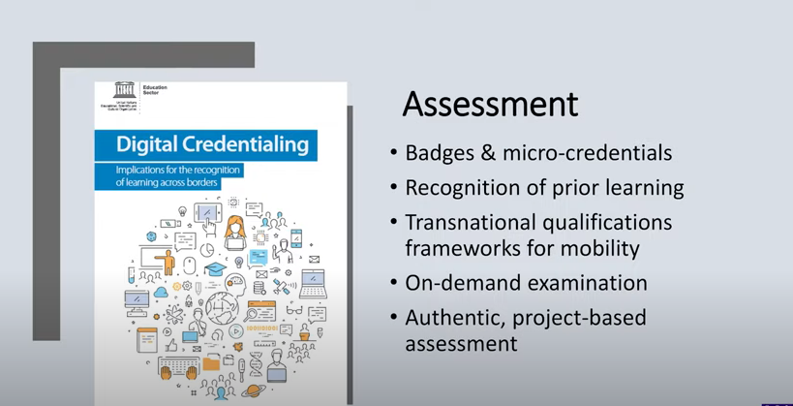
Assessment

Slide 17

Blended Learning

Slide 18

Online Safety

Slide 19

3 C

Slide 20

Connectivity

Slide 21
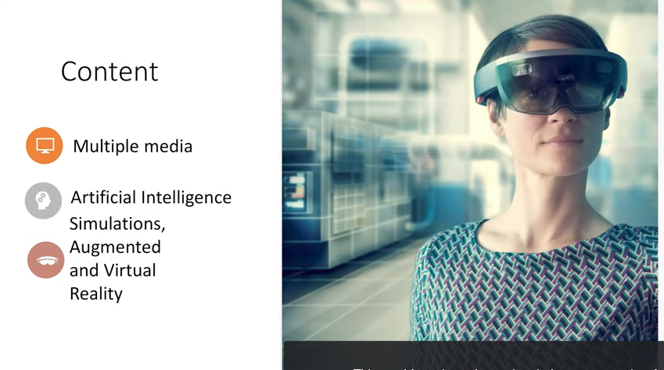
Mindset

Slide 22

Multiple Media (Web Development Level-4)

Slide 23
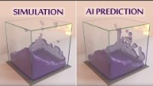
Artificial Intelligence Simulation

Slide 24
How Augmented Reality (AR) Is Transforming The Education Industry
Augmented Reality (AR) continues to grow rapidly, with an estimated
3.5 billion mobile AR users worldwide in 2025, up from 2.4 billion in 2023.
Although AR is widely recognized through popular games like Pokémon Go and
social media platforms like Snapchat and Instagram, its applications extend well
beyond entertainment.
One of the most promising areas for AR is education and eLearning,
where this technology has the potential to transform learning experiences
and boost engagement

Slide 25
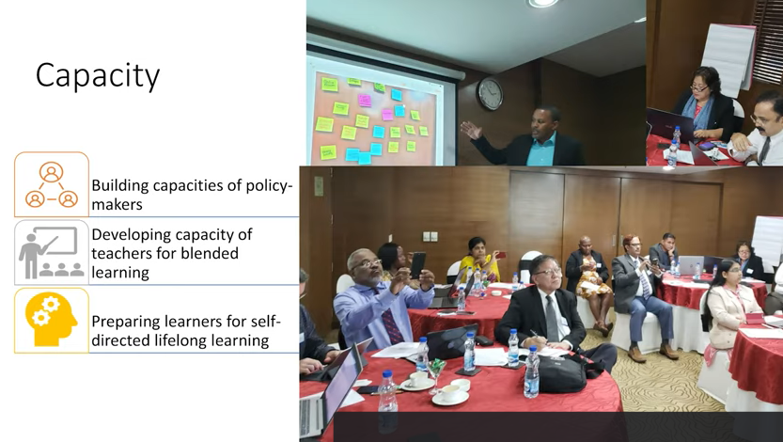
Capacity

Slide 26
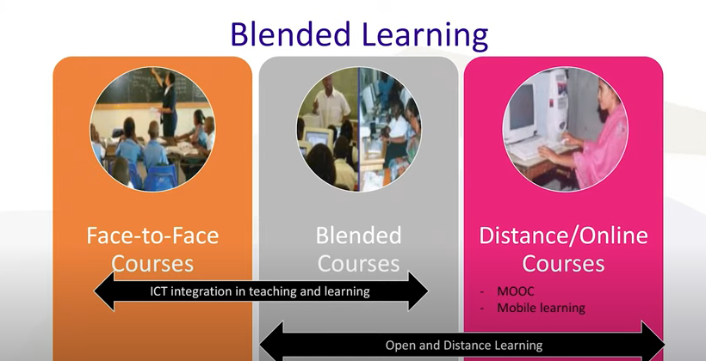
Blended Learning

Slide 27

Best Wishes to All

